Slide 1
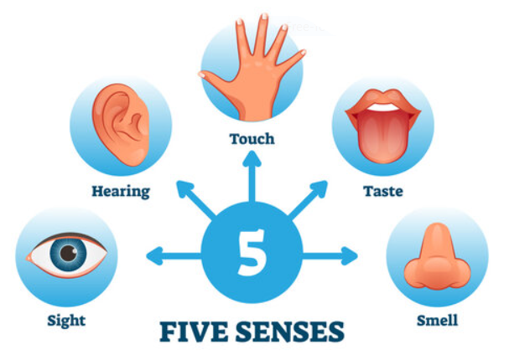




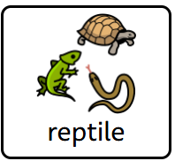
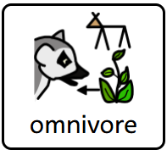
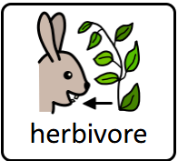
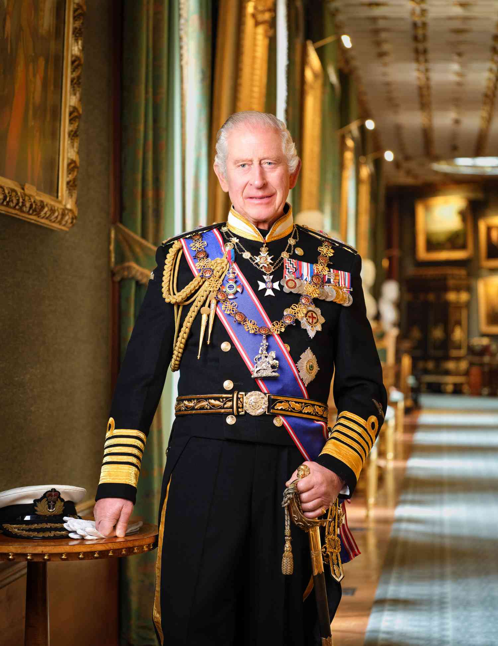
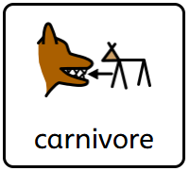
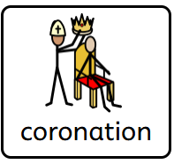
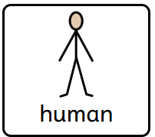
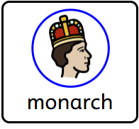
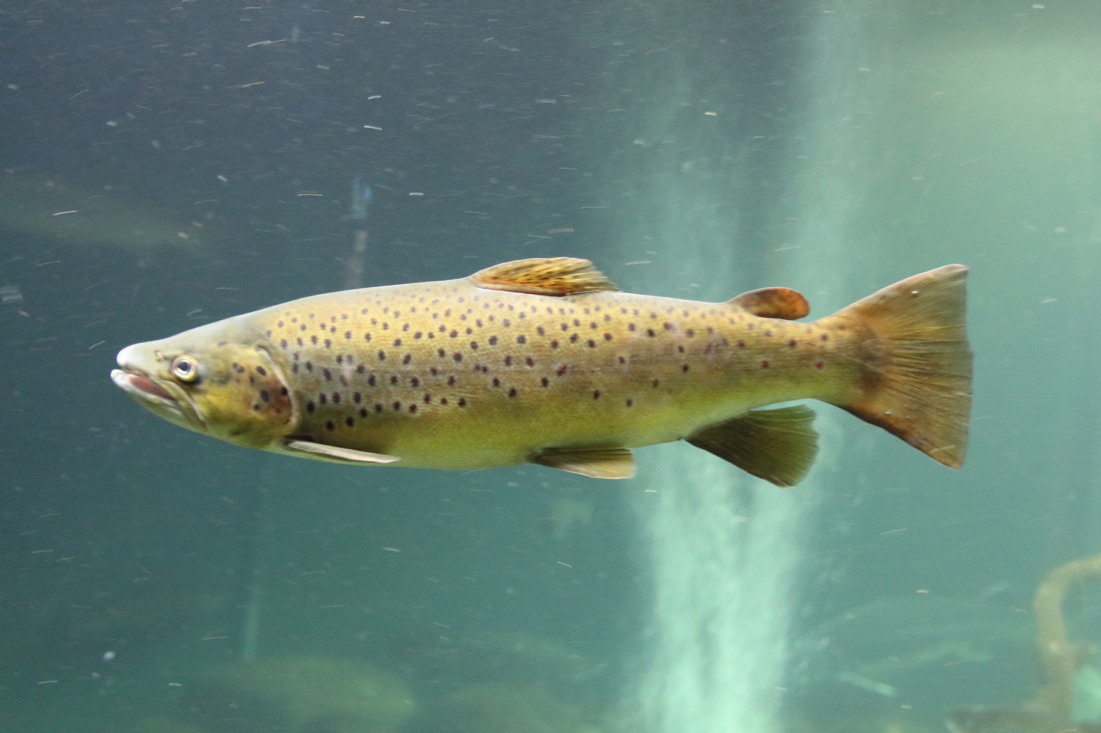
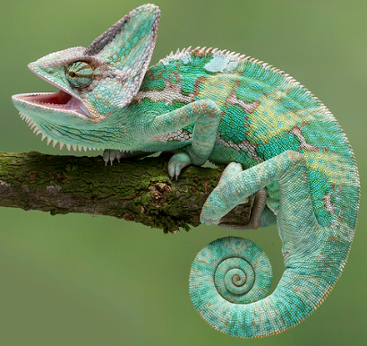
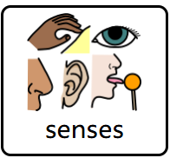
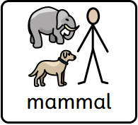
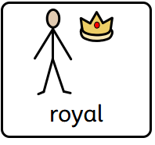
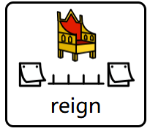
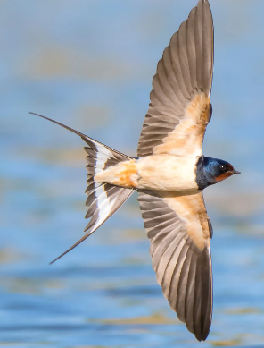
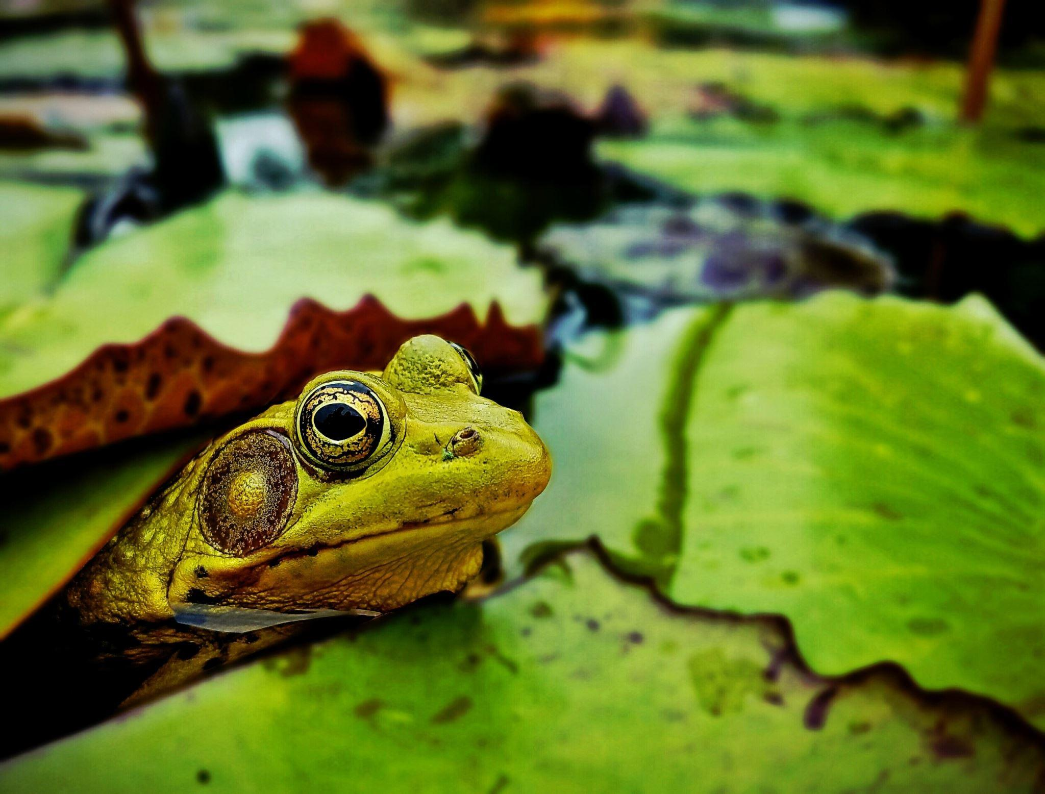
Phase 1 Tell Me About sheet CYCLE A Terms 1 & 2
What Am I?
mini enquiries
Who am I and what makes me special?
What does each part of my body do? (including the senses)
What makes me similar to animals?
What makes me different from animals?
What makes other people special?
What has changed over time?
Word Bank
King Charles III
BIG IDEAS:
People and Places
To know what it means to be a human being and why significant people, places and events matter.
To understand place as cultural, social environment within our world.
Within this Big Idea, our children will be exploring the concepts of:
Migration, influence, empire, civilisation, parliament, peasantry, cause and consequence, significance, similarity, difference, variation, equality, culture, environment, belonging

